Slide 1
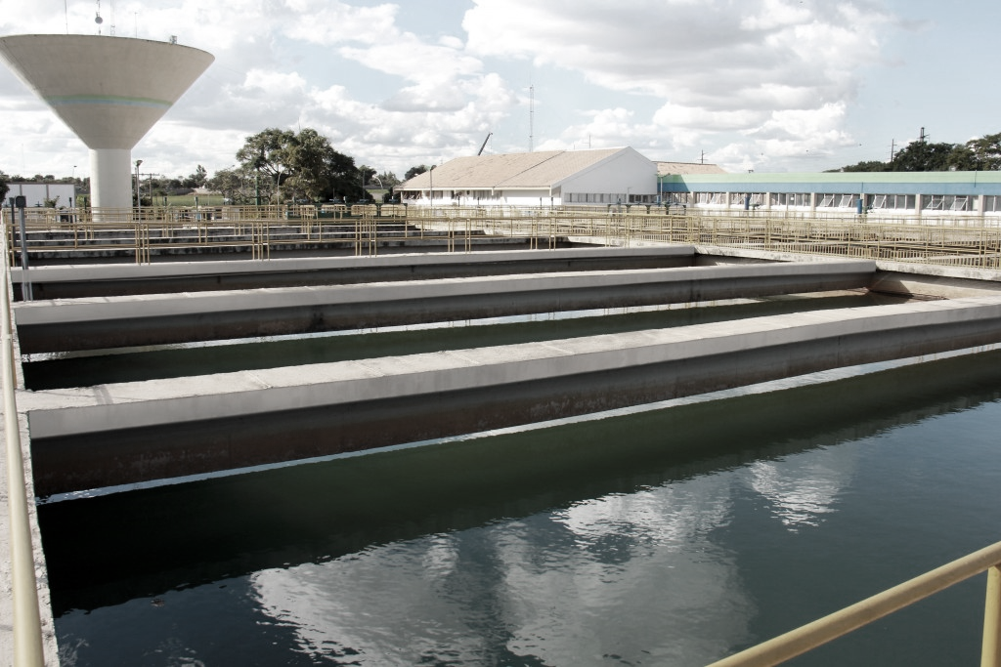
PREPARATORY DOCUMENT
ÁGUAS DE JOINVILLE
SUPPLIERS’MEETINGS
BRAZIL
PARTNER

Slide 2
CAJ SUPPLIERS’ MEETINGS 2022
LOGO
6th - 10th June 2022 – France
COMPANY NAME / TRADE NAME ADRESSE CP - VILLE PAYS WEB SITE: WWW. | CONTACTS NAME: FUNCTION EMAIL: MOBILE: +33
COMPANY PROFILE
MAIN HIGHLIGHTS – KEY FIGURES
ANNUAL TURNOVER Euros / USD |  | EXPORT TURNOVER Euros / USD
EXPORT GROWTH % |  | CAPITAL STOCK (Ltda / S.A)
NUMBER OF EMPLOYEES

Slide 3
CAJ SUPPLIERS MEETINGS 2022
LOGO
6th - 10th June 2022 – France
TECHNOLOGY / PRODUCTS / SERVICE DEVELOPED BY YOUR COMPANY
COMPANY PROFILE

Slide 4
CAJ SUPPLIERS MEETINGS 2022
LOGO
6th - 10th June 2022 – France
EXPORT ACTIVITIES
WHICH COUNTRIES ?
SINCE WHEN?
WHAT KIND OF PARTNERSHIP ?
DOES YOUR COMPANY TAKE PART IN TRADE SHOW / FAIR?
SPOKEN LANGUAGES:
MAIN COMPETITORS:
CAPACITY TO DELIVER YOUR SOLUTION ABROAD?
COMPANY PROFILE

Slide 5
CAJ SUPPLIERS MEETINGS 2022
LOGO
6th - 10th June 2022 – France
EXPORT ACTIVITIES
DO YOU HAVE A CERTIFICATION? | YES | NO
CERTIFICATIONS (PLEASE, SEND US THE FILE OF YOUR CERTIFICATIONS) | ISO 9001 NBR 16001 OHSAS 18001 NAD CAP ISO 14001 SA 8000 AS 9100 Other:
COMPANY PROFILE
HAVE YOU ANY SUCESS STORY TO HIGHLIGHT?
DO YOU HAVE PREVIOUS EXPERIENCES IN BRAZIL?
DO YOU HAVE A LOCAL SALES PRESENCE IN BRAZIL?

Slide 6
CAJ SUPPLIERS MEETINGS 2022
LOGO
6th - 10th June 2022 – France
INNOVATION
WHAT MAKES YOUR PRODUCT/SERVICE INNOVATIVE?
DID YOUR COMPANY ALREADY REGISTER ANY PATENT/TRADEMARK? PLEASE SPECIFY.
DID YOU BUILD ANY PARTNERSHIP IN ORDER TO DEVELOP YOUR INNOVATIVE PRODUCTS/SERVICES?
DID YOUR COMPANY ALREADY RECEIVED ANY RECOGNITION, TROPHY OR WIN ANY PRICE?
COMPANY PROFILE

Slide 7
CAJ SUPPLIERS’ MEETINGS 2022
LOGO
LOGO
LOGO
6th - 10th June 2022 – France
TECHNICAL PRESENTATION OF SHOWCASES
SHOWCASE 1 – ADITIONNAL INFORMATIONS CAN BE SENT USING POWERPOINT
PROJECT NAME (PROJECT OR SERVICE OR WORKPACKAGE)
NUMBER OF ENGINEERS INVOLVED AND THEIR RESPECTIVE SENIORITY LEVEL
LEVEL OF RESPONSABILITY (Tier-1, Tier-2, Tier-3 or Tier-4)
LEVEL OF PERFORMANCE (design/concept; development; detailing; certification; support; etc.)
SCOPE OF THE WORK
ACTIVITIES REQUIRED OF THE PROJECT AND EXPECTED FROM YOUR COMPANY
DELIVERABLES REQUIRED FROM YOUR COMPANY
COMPANY PROFILE
COMPANY PROFILE

Slide 8
CAJ SUPPLIERS’ MEETINGS 2022
LOGO
LOGO
LOGO
6th - 10th June 2022 – France
TECHNICAL PRESENTATION OF SHOWCASES
SHOWCASE 2 – ADITIONNAL INFORMATIONS CAN BE SENT USING POWERPOINT
PROJECT NAME (PROJECT OR SERVICE OR WORKPACKAGE)
NUMBER OF ENGINEERS INVOLVED AND THEIR RESPECTIVE SENIORITY LEVEL
LEVEL OF RESPONSABILITY (Tier-1, Tier-2, Tier-3 or Tier-4)
LEVEL OF PERFORMANCE (design/concept; development; detailing; certification; support; etc.)
SCOPE OF THE WORK
ACTIVITIES REQUIRED OF THE PROJECT AND EXPECTED FROM YOUR COMPANY
DELIVERABLES REQUIRED FROM YOUR COMPANY
COMPANY PROFILE
COMPANY PROFILE

Slide 9
CAJ SUPPLIERS’ MEETINGS 2022
6th - 10th June 2022 – France
CONTACTS
Business France - Brazil
Juliette PETIT
Senior Trade Adviser - Environment
+55 21 96992 1551
juliette.petit@businessfrance.fr
CONTACTS BUSINESS FRANCE
Business France - France
Elsa LACOMBE
Environment Project Manager
Elsa.lacombe@businessfrance.fr

